Slide 1

Current Focus and Priorities
CommsDay Congress October 2016
Teresa Corbin
ACCAN CEO

Slide 2


accan.org.au/events
ACCAN National Conference

Slide 3

No mobile coverage
Cost
Reliability and Guarantees
nbn roll-out problems
Digital First
Direct carrier billing
Lack of information
Content
Slow Broadband
No Ports
Captioning and audio description
Charged more for being low income
Outages and 000
Digital literacy

Slide 4






Better communications services for poorly served areas
Improved consumer safeguards and better regulation
Improved consumer decision making
Digital literacy and Digital Government
Affordable communications
Improved accessibility
Privacy and Cybersecurity
Competition and market structures
Notes:
Better communications in poorly served areas
Improved consumer safeguards and better regulation
Improved consumer decision making
Digital literacy and digital government
Affordable communications
Improved accessibility
Privacy and cyber security
Competition and market structures
Emerging areas – nbn Roll out and IOT

Slide 5
Better communications services in poorly served areas
Increased mobile coverage
  Mobile Black Spots Program Round 2 & 3
  ACCC Mobile Roaming Inquiry
Solutions for areas with inadequate broadband
  ADSL Availability Map
  Interim solutions before nbn arrives
Equivalence of regional and metro
  BIRRR and #datadrought
  Costs for regional users
Notes:
Better Communications for poorly served areas
We will work closely with communities for improvements in existing services and mobile expansion, and for a smooth transition to nbn broadband.
Our focus will be on interim solutions to improve broadband in areas that are currently underserved, and that are not prioritized in the NBN rollout, and on equivalence of regional/metro longer term NBN services. We will support policies that deliver greater mobile coverage and wider choice of provider.
Expand mobile coverage (MBSP Round 2 & 3 – Debate on Mobile Roaming)
Offer options for those living in poorly served areas
Put up slide of Mobile coverage community kit
Put up slide about Get Connected – with URL and Map

Slide 6

accan.org.au/consumer-resources
Community Consultation Guide – 2nd Edition:
Tips to improve mobile connectivity
Mobile coverage is a key issue for consumers
ACCAN’s Community Consultation Guide
helps communities address issues with
mobile coverage in their areas
ACCAN is helping communities understand
what mobile network operators look for
when weighing investment decisions

Slide 7
Better communications services in poorly served areas
Increased mobile coverage
  Mobile Black Spots Program Round 2 & 3
  ACCC Mobile Roaming Inquiry
Solutions for areas with inadequate broadband
  ADSL Availability Map
  Interim solutions before nbn arrives
Equivalence of regional and metro
  BIRRR and #datadrought
  Costs for regional users
Notes:
Better Communications for poorly served areas
We will work closely with communities for improvements in existing services and mobile expansion, and for a smooth transition to nbn broadband.
Our focus will be on interim solutions to improve broadband in areas that are currently underserved, and that are not prioritized in the NBN rollout, and on equivalence of regional/metro longer term NBN services. We will support policies that deliver greater mobile coverage and wider choice of provider.
Expand mobile coverage (MBSP Round 2 & 3 – Debate on Mobile Roaming)
Offer options for those living in poorly served areas
Put up slide of Mobile coverage community kit
Put up slide about Get Connected – with URL and Map

Slide 8
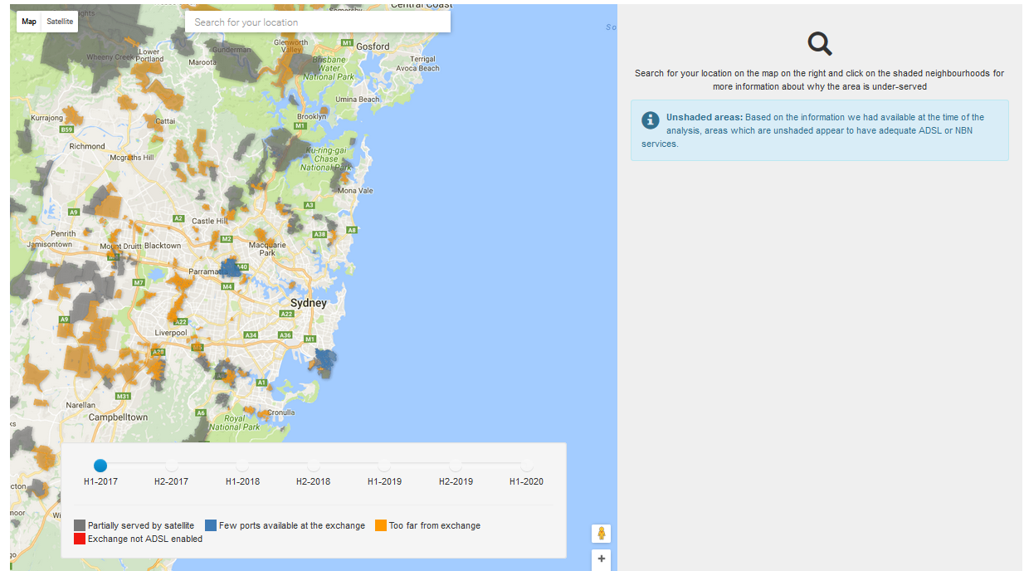
ADSL Availability Map
ACCAN ADSL Availability Map

Slide 9
Six Helpful Steps
Waiting List
Check other fixed providers
Check fixed wireless options
Check home wireless options
Check mobile broadband options
Share your experiences and solutions

Slide 10
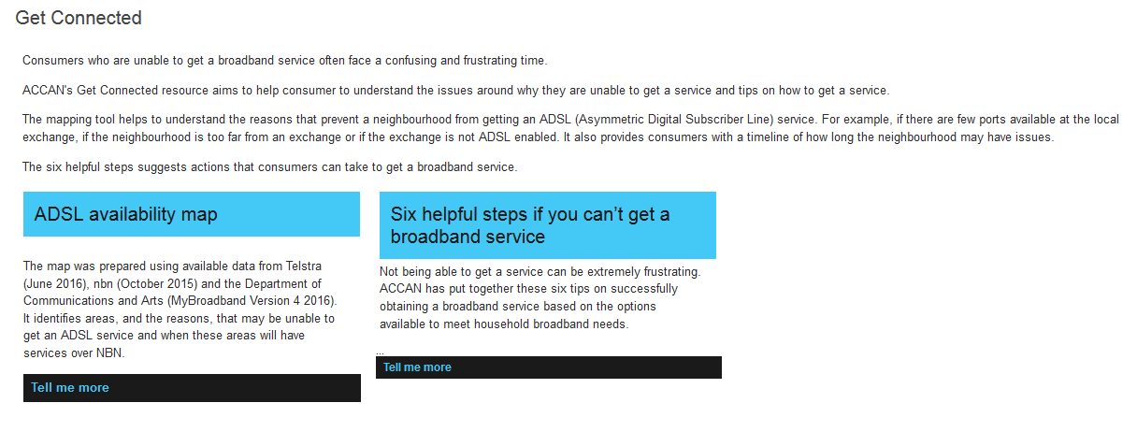

Slide 11
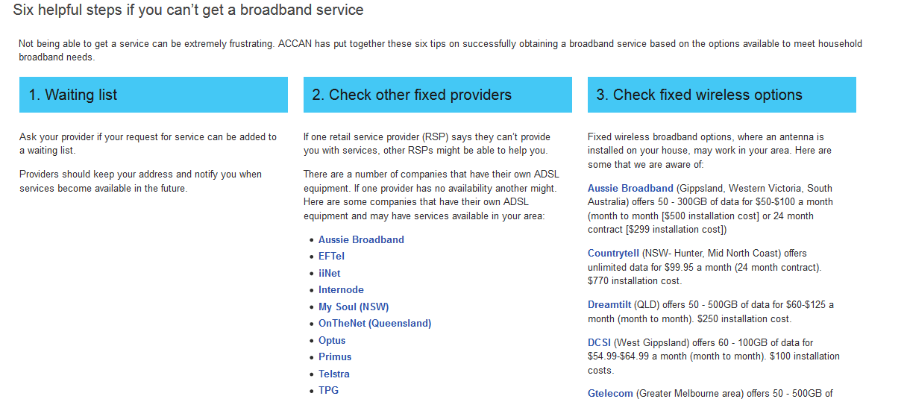

Slide 12
Future protections and universal communications services
PC Inquiry into Universal Service Obligation (USO)
Departmental review Consumer Safeguards
  Customer Service Guarantee (CSG)
  Wholesale level guarantees & benchmarks
  Review of TCP Code
Notes:
We will advance consumer protections needed for the delivery of essential communications services.
Our focus will be ensuring safeguards are reformed so they are relevant to the needs of todays’ consumers. We will engage in reform of universal services, the Federal Government’s consumer safeguards review, and reviews of industry codes and guidelines.

Slide 13

ACCAN’s 6 key principles of a
Connected Consumer
  access to voice and data services
  affordable
  standardised
  accessible to all consumers
  engagement with online services
  digital literacy and empowerment
  ACCAN Connect Consumer position statement

Slide 14
Improved consumer decision making
Independent Broadband performance benchmarking
Consumer access to own data – (eg miData)
Better tested models for T’s & C’s
Good comparison tools
ACCAN consumer info materials
Notes:
We will support a competitive market by giving consumers the tools they need to participate.
This is all about self help and empowerment – provides tell me their focus groups say that many consumers want more tools they can use
Our focus will be the introduction of easy to use independent broadband performance benchmarking information; and secure consumer access to own data to guide better purchasing decisions. We will provide timely and useful product information to support better consumer choices.
Put up slide about Get Connected – with URL and Map

Slide 15

Confident but Confounded

Slide 16
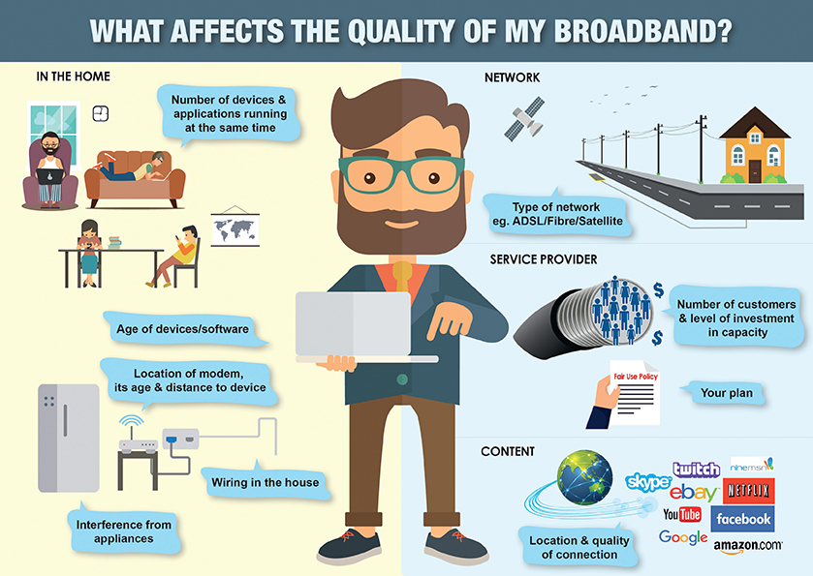

Slide 17
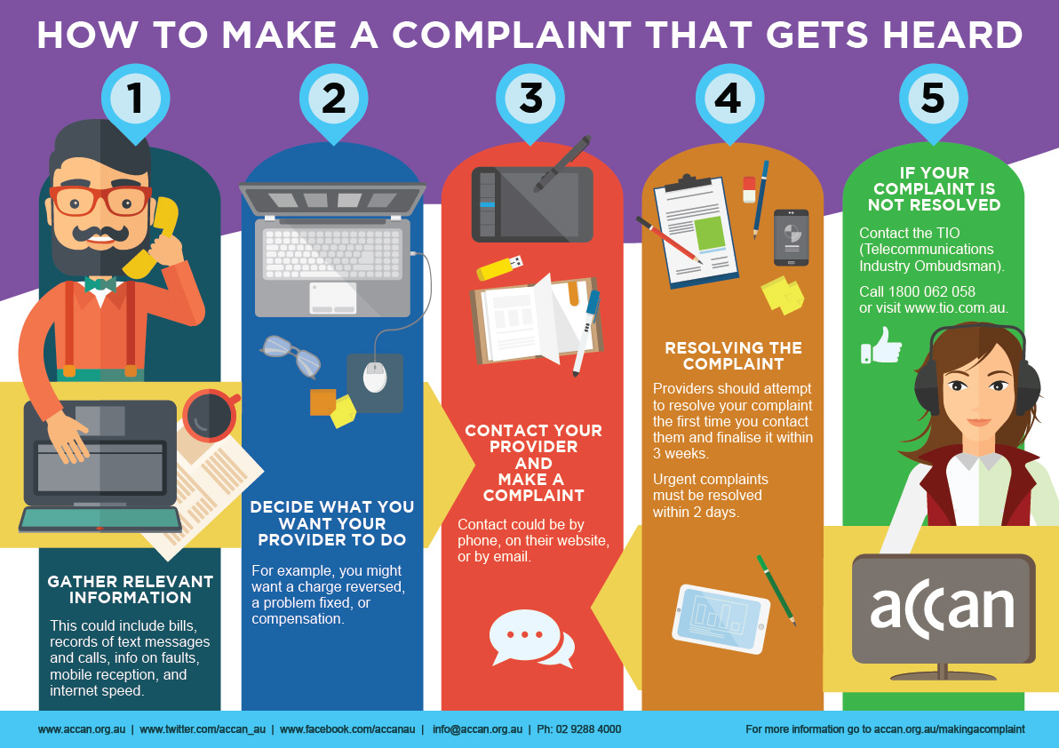

Slide 18


Slide 19

http://accan.org.au/broadband
A Guide to Sky Muster services:
Tips on connecting to satellite services
What to expect from these services
Navigating the retail market
What to do if you have trouble connecting
Information for communities and school of
the air families.

Slide 20

Digital Literacy and Digital Government
Inclusive digital government – Digital Transformation Office should bring community with it
ACCAN’s digital literacy tools and e-learning platform for small businesses digital ready
Notes:
We will support community capacity building to enable consumers to engage with digital government. We will advocate for inclusive digital transformation by government to ensure citizens and small businesses are not left behind as services are transitioned to online delivery.
Our focus will be to work on measures that remove barriers to consumer online engagement with essential government services, informed by international best practice. We will promote delivery of ACCAN’s digital literacy training material, and support the work of member organisations delivering digital education programs.
Digital Transformation Office should bring community with it

Slide 21

Affordable Communications
Affordability Research Map
accan.org.au/our-work/research/1241-affordability-map
Centrelink Telecommunications Allowance
  Analogue entitlements in a Digital Age
Australian Digital Inclusion Index
Notes:
We will strive to eliminate cost barriers for low income consumers, and promote better value for all.
Our focus will be to work with industry and government in developing informed and targeted responses that are suited to consumer need. We will support reforms to the Centrelink Telecommunications Allowance, improved hardship arrangements, and advocate for better deals for low income Australians.
As our communications market continues to develop and the essential nature of network connectivity increases, issues of affordability for many Australians are creating barriers to our communications networks. Overcoming these barriers is increasingly important as government services and information become ‘digital by default’. Ensuring that all Australians are able to afford to connect to communications networks and services suitable to their specific needs will increase economic, social and community participation.
The purpose of this paper is to identify the different groups in Australian society that face affordability issues. A better understanding of how affordability issues differ between - or are common to - groups will enable us to make more informed recommendations to industry and government. It will also help us to work with industry to develop more appropriate targeted low-income measures, to reach and benefit more Australians.
The paper will define what affordability means and give a general introduction to telecommunications affordability in Australia. It will then set out the different groups in Australian society that face unique affordability issues and attempt to identify what these issues are.
The groups ACCAN has identified as facing unique barriers to telecommunications affordability are: people facing homelessness; low-income families; people with disability; students; older people; people receiving the lowest government income support payments (Youth Allowance and Newstart Allowance); migrants and asylum seekers; Aboriginal Australians and Torres Strait Islanders; the unemployed; prisoners; and people who live in social housing. Evidently this list is not exhaustive and the document will continue to grow as more information becomes available.

Slide 22
The Australian Digital Inclusion Index 2016

Slide 23
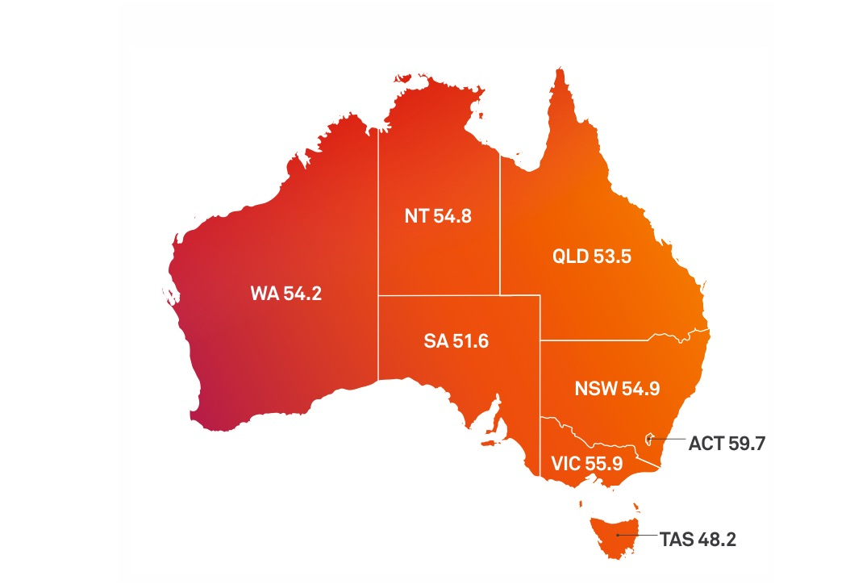
Unequal outcomes for digital inclusion across
Australia…
2016 scores
Australia = 54.5
Notes:
Digital inclusion is, unsurprisingly, geographically variable. At state/territory level, Tasmania has lowest level of inclusion, while ACT has the highest, followed by Victoria(note exclusion of some remote communities from NT data).
The data also demonstrated a ‘country-capital divide’, with capital cities/large metropolitan centres typically having more digitally included residents than rural areas and smaller regional centres.
The overall ‘Capital–Country gap’ has widened marginally over time, but this trend is not consistent across the three sub-indices. Nationally, the Access gap for Capital–Country has actually narrowed marginally, while the Affordability and Digital Ability gaps are widening.
There are, however, some surprises when comparing ‘like’ regions (eg Wollongong and Geelong)

Slide 24
Improved accessibility
NRS Review
National Disability telecommunications Service
Accessible ICT procurement
Real Time Text & international developments
Audio description
Broadcast captioning
Notes:
We will partner with our members to call for the removal of discriminatory barriers to access.
Our focus will be the adoption of a government purchasing policy for accessible ICT products and services; the local introduction of Real Time Text to align with international developments; the introduction of a National Disability Telecommunications Service. We will advocate for accessible online services and web video content, and for audio description and improved live captions on broadcast television. We will ensure consumer needs are central in reviews of NRS services, and monitor innovations that deliver improved accessibility.

Slide 25
Privacy and Security
National Digital Identity
Data breach notification law
Do not call register
Security of personal data
Notes:
We will ensure that consumer privacy is maintained in interactions with government and business, and that consumers are empowered and informed.
Our focus will be to ensure that digital national identity works in the best interests of consumers, and the security of personal data. We will work for an improved Do Not Call Register, and for the introduction of data breach notifications.

Slide 26
Additional Areas
Internet of Things
NBN Roll-out
Competition and Market Structures
  ACCAN market watch, net neutrality, ACCC market Study & mobile roaming inquiry
Notes:
“Home, Tweet Home”: Implications of the Connected Home, Human and Habitat on Australian Consumers by Alexander Vulkanovski ACCAN Intern (of Things) February 2016
There are many emerging issues with the nbn roll out
We will advocate for competition and transparency between ISPs and content providers, to ensure the internet works for the best interests of consumers.
Our focus will be to identify and respond to prioritisation of online network traffic, and to ensure that consumer interests are taken into account in commercial arrangements to deliver online content. We will monitor the effect of market changes on service delivery for consumers.

Slide 27
accan.org.au
Australian Communications
Consumer Action Network
Your consumer voice on phones and internet
Equipping consumers to stay connected
Free subscription to weekly WebNews@accan.org.au
Twitter: @ACCAN_AU
Facebook.com/accanau
02 9288 4000

