Slide 1
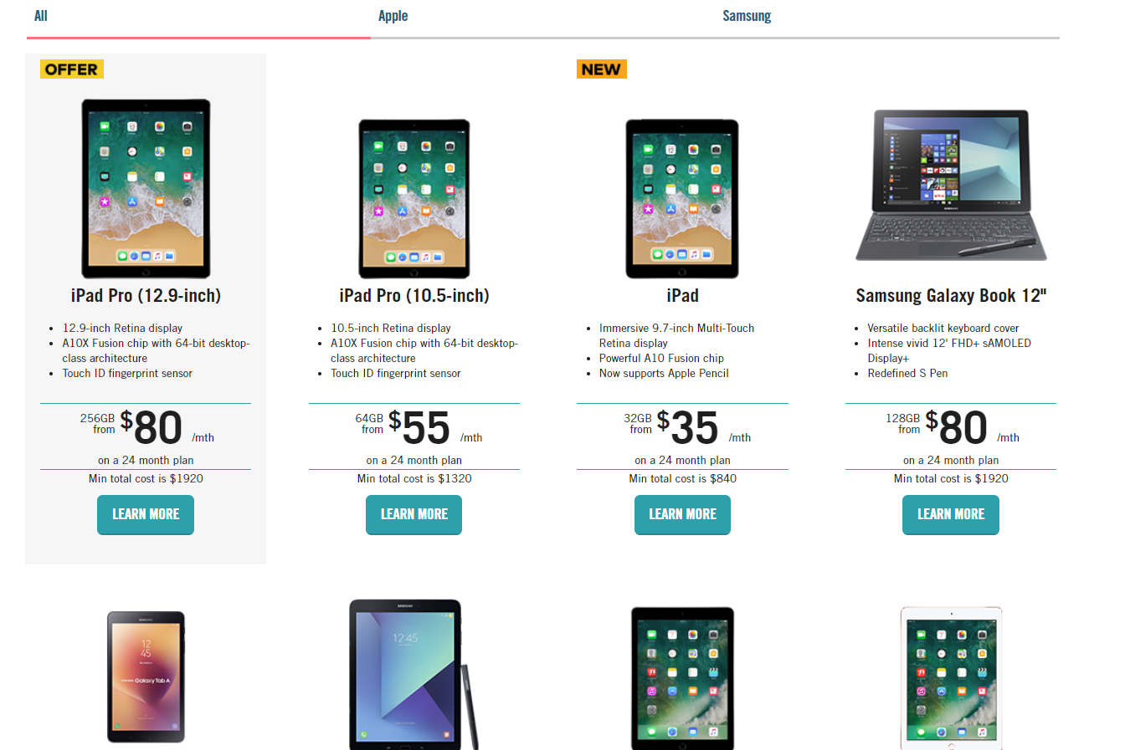

Slide 2
Critical Information Summary
Unlimited 5GB - 6 Months Starter Pack
Valid 20 October 2017
Unlimited 5GB - 6 Months Starter Pack
INFORMATION ABOUT THE SERVICE
This is a SIM only (BYO Phone) Post-paid mobile Service plan where you Pre-pay the Unlimited inclusions for a period of 6 months. Excess charges not included in the Unlimited 5GB Plan will be charged on a Post-paid basis where you opt-in for those Services.
Monthly Standard Credit
UNLIMITED
What’s Included In Standard Credit?
Standard credit includes calls to Australian mobiles and fixed line numbers including 13 and 1300, MMS to standard mobile services within Australia and Voicemail Deposits and Retrievals within Australia. 1800 calls incur no cost. Fair Use Policy applies to all Vaya services. All standard SMS (sent within Australia to other Australian mobiles) will not be charged.
What’s Excluded From Standard Credit?
All International calls and SMS, third party premium services (usually starting with 19), Voicemail Call Return, Directory Assistance and calls to numbers starting with ‘12’ are charged directly on top of your plan. For full costs of these, please refer to w ww.vaya.net.au
Monthly Data Allowance
5 GB (5120MB) If your data allowance is used in any one calendar month, you may opt-in for additional 1GB data packs. Excess data packs are charged at a rate of $10 per 1GB, billed in increments of 1GB. Data on mobile networks counts uploads and downloads. 1GB data packs reset at the end of your billing month.
Fair Use Policy
Fair Use Policy refers to “unreasonable use” on this particular plan. Please review the following link for further information: www.vaya.net.au/?option=Fair%20Use%20Policy
What You Need
To use this Vaya Mobile plan, you must have a mobile phone. We will supply the SIM only.
Minimum Term
6 Months
This plan must be activated within 12 months of purchase. If not activated within 12 months, all inclusions will be forfeited without further notice to you.
INFORMATION ABOUT PRICING
Standard Call Rate Flagfall Cost of a standard 2 min call Billing increment SMS/MMS 1800 Calls Excess Data Included Data Increment International SMS International Calls required) Voicemail Cost of using 1MB of data in Aust.
Minimum Upfront Cost
N/A N/A N/A per minute 0c
0c $10 per 1GB Per KB 25c per SMS (Opt in required)
Visit vaya.net.au (Opt in
N/A $0.0049
$150
You will be charged the minimum upfront cost when you purchase your SIM card.
After 6 months we will contact you and request that you chose a new Vaya plan or you may cancel your Service altogether. If you do not chose a new plan and to ensure that you are not without a mobile Service, the plan will automatically revert to a similar month to month plan based on your usage at the time.
PLEASE NOTE: Once opted in, If you use more than your included plan credit or data allowance, or use your Service for things which are not included in your plan credit, you may pay more in a given month, billed at the above listed rates.
Included data allowance is calculated per KB. Once the included data allowance has been used you will be charged an excess charge of $10 per 1GB, billed in increments of 1GB.
Other Fees And Charges
Late Payment fee: $15 Dishonour fee: $15 Plan change Fee: $5 New mobile number fee: $10
Coverage
Your mobile service will be carried on the Optus 4G Plus network. Please check your coverage at XXX before purchasing.

