Slide 1
The impact of Artificial Intelligence in the connected world
  Hugh Bradlow – Chief Scientist, Telstra
Notes:
The reverse is also true – not only does AI have impact on the connected world but connectivity has huge impact on AI

Slide 2
Outline
Digital platforms
Big Data and AI
AI in the real world

Slide 3
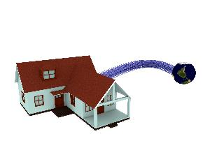


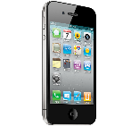

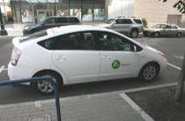

Today’s Digital Transformation Environment
Fixed and Mobile Broadband
(media-centric and cloud-centric)
Internet Connectivity – public and private
Cloud computing
(abundant computation on demand)
Image: Twin Design / Shutterstock.com
Picture: Tom Brandt under Creative Commons
Picture: Crowdfunding | by Rocío Lara Crowdfunding | by Rocío Lara
On-demand economy
Sharing economy
Crowdsourced economy

Slide 4
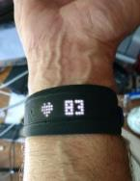
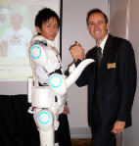
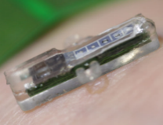
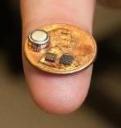
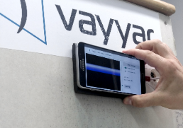

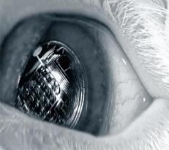
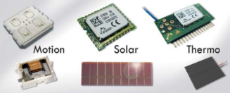
The Internet of Things:
Everything that can be measured, will be measured
Today, more than 99% of things are still not connected*
Sensors and actuators
  MEMS
  Chemical
  Imaging – Cameras, Micro Wave
  Acoustic
  Biological
Distributed intelligence
Power
Weight/Size
Notes:
Exponential growth in connected devices (from Andrew Scott’s presentation of 13/5/2014)
50 billion devices by 2020
3.5 connected devices / person 2015
6.6 connected devices / person 2020

Slide 5




What is involved in creating the Internet of Things?
Harvest Readiness
Networks
Water management
Tractor control
Horizontal “Platform”
Devices
Networks
Cloud services
Industry
Specific Applications
Device management
Network management
Data collection and storage
Generic analysis capabilities: visualisation, alerts, etc
DEVICE MANAGEMENT
DATA MANAGEMENT
DATA VISUALISATION
ACCESS NETWORKS & SUBSCRIPTION MANAGEMENT
DEVICES AND ASSETS

Slide 6

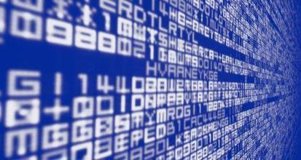
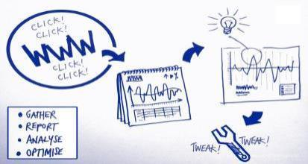


Abundant Computing -> Abundant Data -> New Analytics = Artificial Intelligence
SQL sources
(DW, CRM, CDR)
Data lake
New analytics
(search, machine learning, probabilistic analysis)
Unstructured &
Real-time sources
(usage, IoT, content)
Streaming analytics
Notes:
Search-driven analytics: ThoughtSpot
Cisco cloud index (http://theinstitute.ieee.org/ieee-roundup/blogs/blog/artificial-intelligences-potential-will-be-realized-by-quantum-computing): 1.3 zettabytes of data per month data centre traffic globally

Slide 7
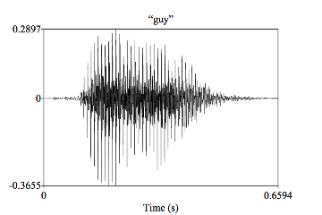
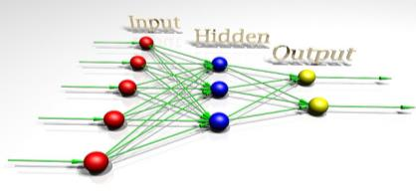
Why is machine learning different?
Move from ‘model-driven’ to ‘data-driven’
Output:
“guy” – yes or no?
Input
Picture: fdecomite under Creative Commons
Picture: Linguisticmystic.com under Creative Commons
Notes:
Output of each node is a function of weighted inputs
Weights are ‘trained’ to give the maximum probability of identifying the input pattern correctly
The relationship between the result and the input is not obvious
The system has to perform matrix and vector manipulation (which is why graphics processors are so popular)

Slide 8
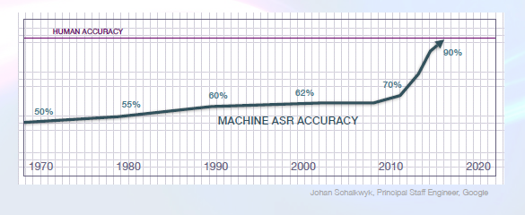
Impact of Machine Learning:
Example of speech recognition
From Marsal Gavalda: http://uilab.kaist.ac.kr/~NoSyu/data/KAIST_2015-Building_industrial-strength_APIs-Marsal_Gavalda.pdf

Slide 9

You can’t talk to the trees, but you can talk to your home
“Lock the doors”
“Play Beatles Abbey Road”
“Turn on the lights”
Notes:
Voice interfaces
Gesture interfaces
Brain Interfaces

Slide 10
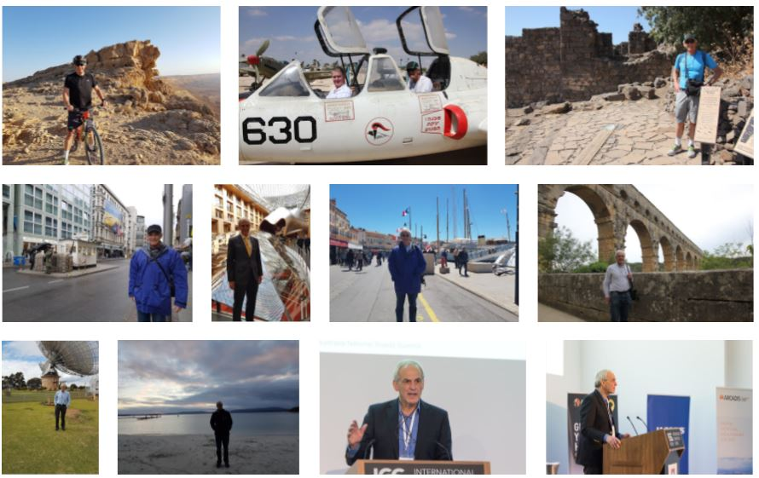
Machine vision
Notes:
Robocops get robocars
Dubai recently announced that it would be deploying robocops on its streets this year [1]. Now it is intending to complement them with robocars, also this year. The small, 4 wheel autonomous vehicles, which are made in Singapore, will be equipped with cameras with face recognition to track suspects. They will also be able to launch a companion drone to do aerial surveillance. Thermal imaging and license-plate readers will further enhance their investigative capabilities. The vehicles can navigate autonomously or be tele-operated from a control room. They will only move at walking pace so there will be no high speed robo-chases [2].
[1] Weekly Technology Trends – Issue 287 – 31 March 2017
[2] Washington Post
4. China Is Using Facial Recognition To Nab Jaywalkers; Investors Get Interested
A Chinese startup that sells facial recognition systems to police forces secured venture-capital funding that values it at more than $1.5 billion, underscoring the sector’s emergence as one of technology’s hottest areas of interest. Beijing-based SenseTime, which provides surveillance systems using facial recognition to Chinese law enforcement agencies, said Tuesday it raised $410 million in new funding from investors, lifting it to so-called unicorn status with a value of more than $1 billion. Using artificial intelligence, facial recognition systems from SenseTime and others can identify people in a crowd by matching their faces against those on file in image databases. Facial recognition works by breaking down a person’s face into a series of measurements and using them to create a template that can be compared with others in a database. In China, adoption has been especially swift, aided by a large network of surveillance cameras, a national photo ID index and relatively few concerns about privacy. Customers include law enforcement agencies who use the technology to identify and detain criminal suspects. It is also being used by local governments to discourage behaviors like jaywalking. SenseTime, which also provides facial and image recognition to the finance and mobile internet sectors, was founded in 2014 and has 500 employees. Local Chinese governments are among its biggest clients. The company will use the funding raised to retain and hire talent and pay for research into other technologies that rely on artificial intelligence, including self-driving cars and medical diagnostics, said Chief Executive Xu Li.
https://www.wsj.com/articles/saving-face-investment-in-recognition-technology-heats-up-in-china-1499763603

Slide 11
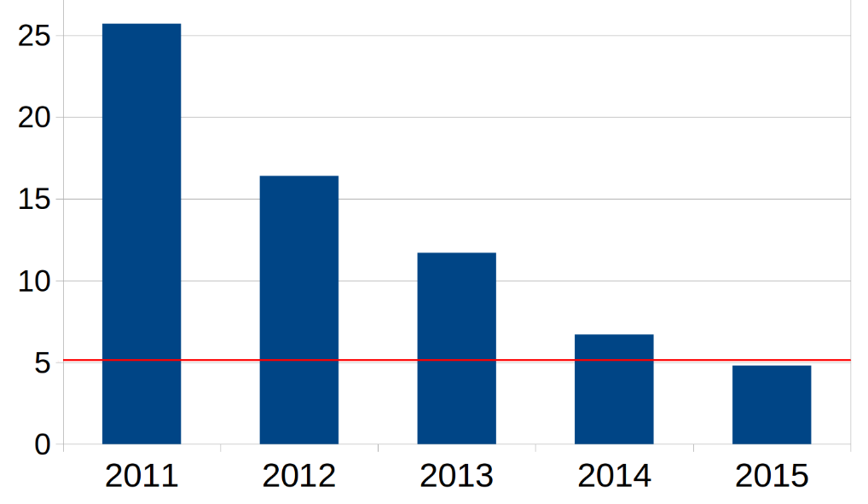
Impact of deep learning:
Image object recognition challenge
Imagenet Large Scale Visual Recognition Challenge
Error rate %
Human accuracy
Picture under Creative Commons from https://commons.wikimedia.org/wiki/File:Classification_of_images_progress_human.png
Notes:
Object Recognition: Imagenet
Reference: https://qz.com/1034972/the-data-that-changed-the-direction-of-ai-research-and-possibly-the-world/
Imagnet: 13m images tagged
Recognise objects based on WordNet ontology of 155,000 words. Aim of 500 images per word (only nouns at the moment)
Face Recognition: MegaFace
Reference: http://megaface.cs.washington.edu/results/facescrubresults.html
Recognise faces from a database of 1m pictures of 690,000 people

Slide 12


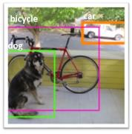


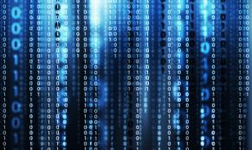

Limitations of Machine Learning
No “one-shot learning”
Single domain
Training dataset
Training time
Notes:
Allen Institute of Artificial Intelligence limitations: reasoning and common sense; natural language understanding.

Slide 13
Real-world impacts of AI
Notes:
I am not going to cover all the obvious stuff - I want to look beyond the things you could and should be doing today:
like moisture/temp/nutrient measurements
Drone or satellite multi-spectral surveillance
Big Data to determine optimum plant/harvest times
Automated equipment such as tractors and harvesters

Slide 14
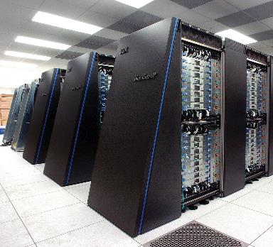
Telecommunications
Physical Infrastructure
Network Cloud
Virtual network functions
Application
Cloud
Fibre
Application
Cloud
Application
Cloud
Telco, 3rd party and customer applications
Telco, 3rd party and customer applications
Telco, 3rd party and customer applications
3G / LTE/5G
SDN control
Physical resources
https://en.wikipedia.org/wiki/File:IBM_Blue_Gene_P_supercomputer.jpg
ADSL, HFC, FTTP, Wireless, Satellite
Classical / Synaptic / Quantum Computers.
Network technologies
Business to Consumer Services
Notes:
Optimisation of routing in a network-sliced and SD-WAN world
Biggest impact is on customer service – the dreams of proactive maintenance and mass customisation may finally be realised

Slide 15
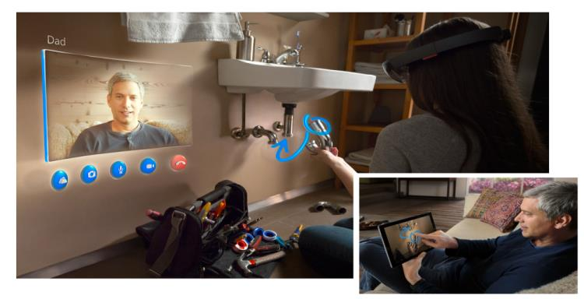
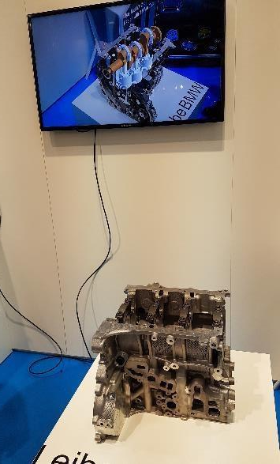
Field service and Augmented Reality
Image with permission of Microsoft

Slide 16
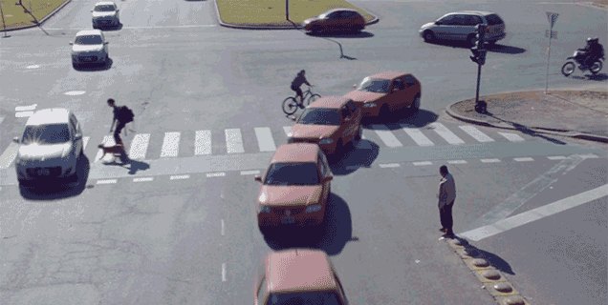
Transport
Video with permission of Professor Gerhard Fettweis, Vodafone Chair at Technical University of Dresden, pioneers of the “Tactile Internet”

Slide 17
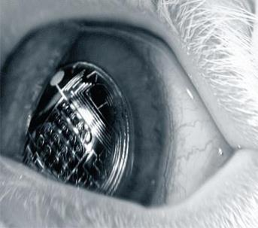
Law enforcement –information on demand
Internet
http://spectrum.ieee.org/biomedical/bionics/augmented-reality-in-a-contact-lens

Slide 18
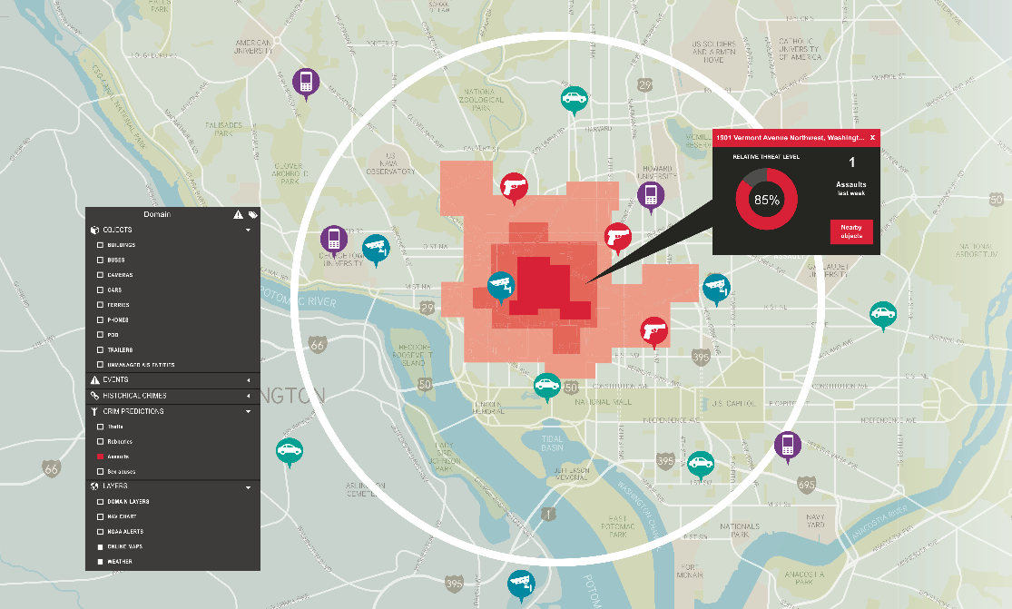
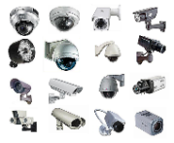
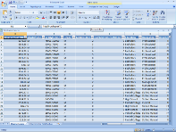
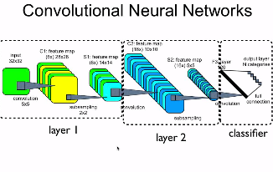

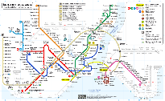
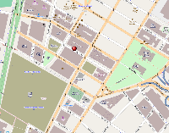
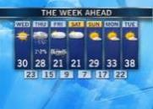
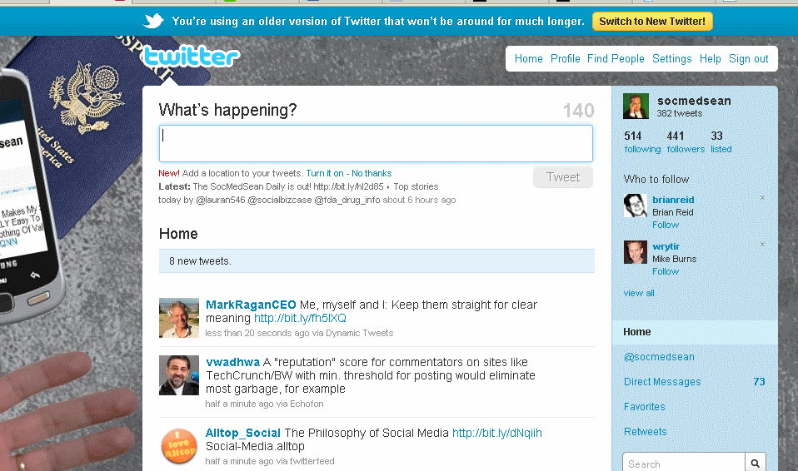

Law enforcement: “pre-crime”
Data Sources
Cloud Databases and tools
Machine learning algorithms

Slide 19
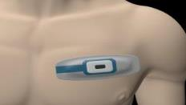




Health: A personal physician 24x7
Bluetooth
4G LTE
Wi-Fi
Cloud Provider
Notes:
Telstra Example: Telstra Health focussing on telehealth and remote monitoring

Slide 20
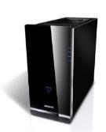

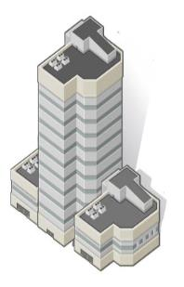

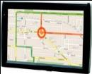






Real-time optimisation and decision support
System-wide
state server
GPS Satellite Network
Cellular
Wireless
Networks
Traffic Control Centre
GPS combined with 2-way data
External servers:
Environmental Data

Slide 21



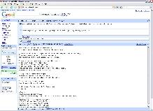
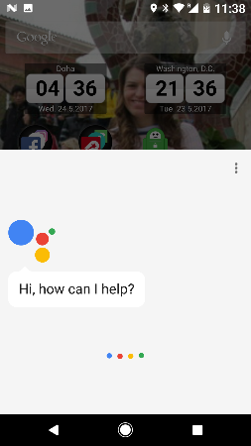
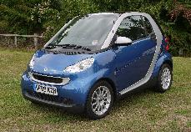


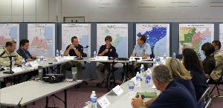
Virtual Personal Assistants
Pictures under Creative Commons from Bing Search

Slide 22
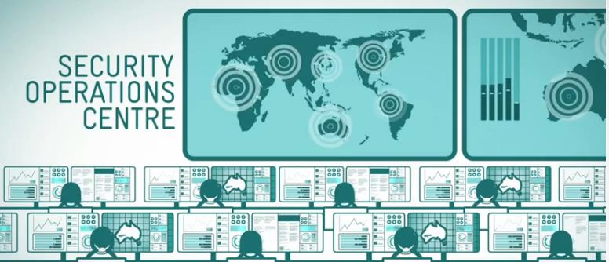
Cyber security
Real-time context-aware risk ratings
✓
✗
Realtime
Identity
• Authorization
• Delegation
• Device
Traffic analysis
• Volume
• Metadata
• Content (DPI)
Logs
• Access
• Network
• Apps
Intelligence
• Malware
• Honeypots
• Trip-wires
Context
• Location
• Application
Notes:
Gartner Call this space User and Entity Behavioural analytics (UEBA)

Slide 23
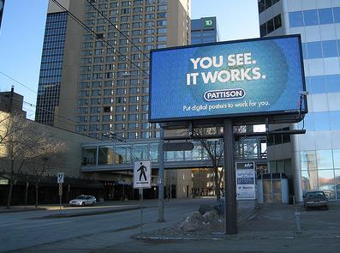
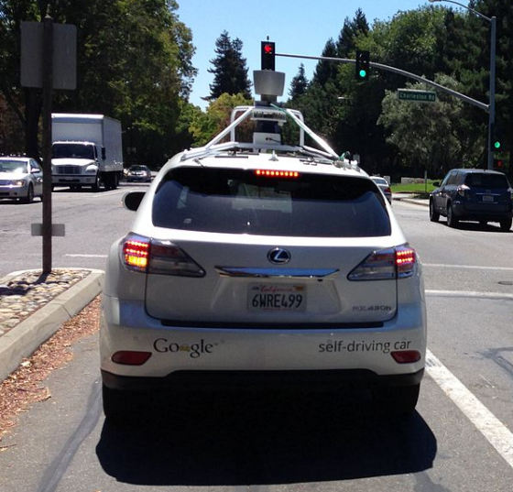
Emerging threats
Picture under Creative Commons by Mack Male https://www.flickr.com/photos/mastermaq/3226521389/
Picture under Creative Commons from https://commons.wikimedia.org/wiki/File:Google_self-driving_Lexus_SUV_rear_view.jpg
Notes:
Machine learning vulnerable to hacking
In every new technology the initial enthusiasm for the novel capability results in security being ignored. Machine Learning is no different in this respect and at a recent conference researchers showed that machine learning systems were vulnerable to hacking by attackers feeding them the wrong data. For example, an electronic billboard could be used to deceive the machine vision systems of a self-driving car, or inaudible sounds used to attack the speech recognition system of an artificial assistant which could then be asked to download malware. The attacks could be difficult to protect against because by feeding the system with false data, you can retrain the neural network. For example, spammers have for some years been feeding spam filters with misleading emails to enable them to penetrate the filters at a later date [1].
[1] MIT Technology Review
Robust physical-world attacks on machine learning models: https://arxiv.org/pdf/1707.08945v1.pdf

Slide 24
Be prepared
The pace of AI development is exceeding the timescale of business reaction
AI is a massively over-hyped field
BUT
BUT: that doesn’t mean it does not have widespread application

Slide 25
Thank you

