Slide 1
Connecting with consumers

Slide 2
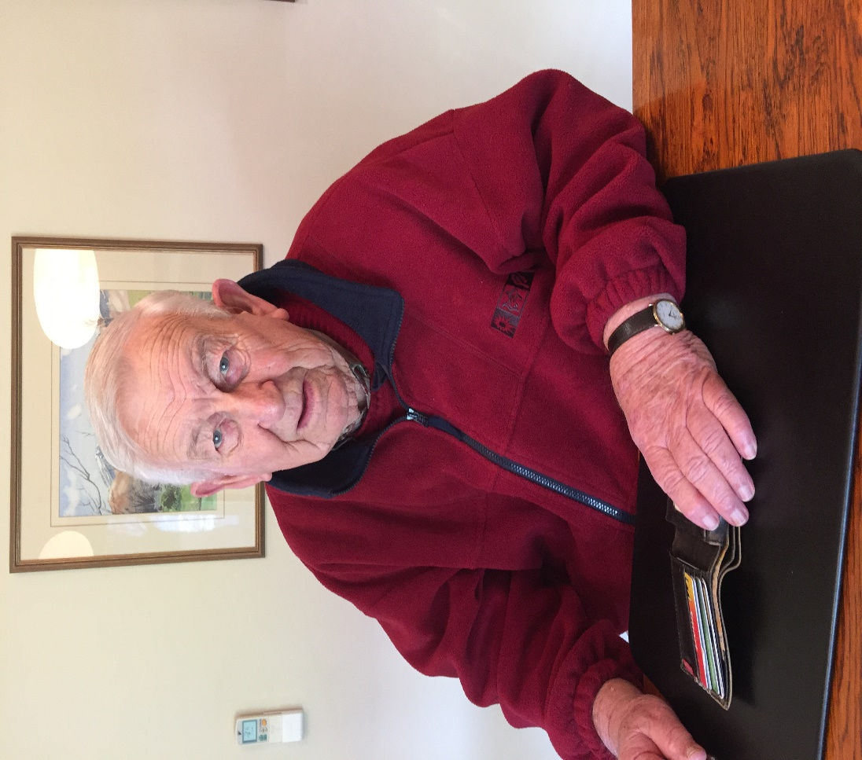
Dad – sometimes the yardstick

Slide 3
Marketing strategy
“ Every successful telco used confusion in pricing as its chief marketing tool.” – former Telecom CEO Theresa Gattung

Slide 4
Comparison sites

Slide 5
State of NZ connectedness
The Government has invested $2 billion into two major initiatives – Ultra Fast Broadband and Rural Broadband Initiative.
Together they are meant to bring improved internet connectivity to 97.8 percent of New Zealanders.
By 2022 80 percent of Kiwis should have access to the internet using UFB.
Because it’s not feasible for every rural community to get UFB, broadband with peak speeds of at least 5 megabytes per second, is being provided to more than 90 percent of homes and businesses outside of UFB areas.

Slide 6
Early adopters
According to the TCF, New Zealand is leading the pack in the developed world in the speed of our switch to fibre optic broadband, with a 250% increase in total connections last year – the highest in the OECD

Slide 7
Other trends

Slide 8
Consumer Trusted
We run a Consumer Trusted accreditation scheme for businesses. The area we struggle most with is the unfair terms in contracts, particularly telco contracts

Slide 9
Telecommunications Disputes Resolution Service

Slide 10
Recurring issues
Internet data and roaming charges
Agreements at point of sale
Service transfers
Transfer and connection delays
Moisture damaged handsets

Slide 11
Number it receives

Slide 12
Thank you
Ka Kite Anu

