Slide 1
Get Connected
Will be launched tomorrow, Friday 16th
Website: accan.org.au/get-connected
Media enquires to Luke Sutton luke.sutton@accan.org.au

Slide 3
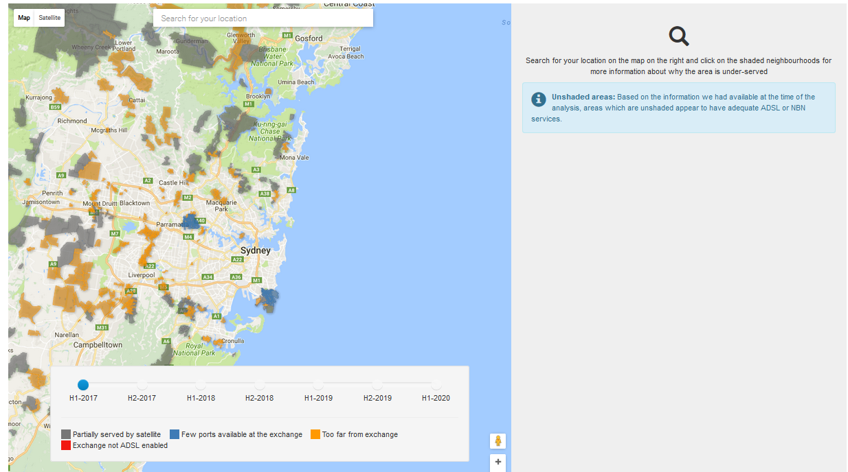
1. ADSL Availability Map
The ADSL Availability Map
Video interview of Ken describing the analysis
The ADSL Availability Report

Slide 4
2. Six Helpful Steps
Waiting List
Check other fixed providers
Check fixed wireless options
Check home wireless options
Check mobile broadband options
Share your experiences and solutions

Slide 6
accan.org.au/
get-connected

