Slide 1
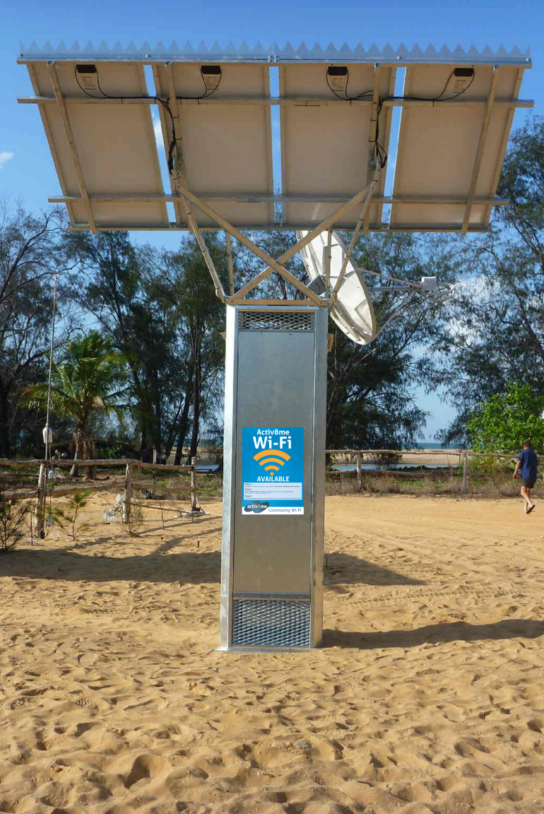
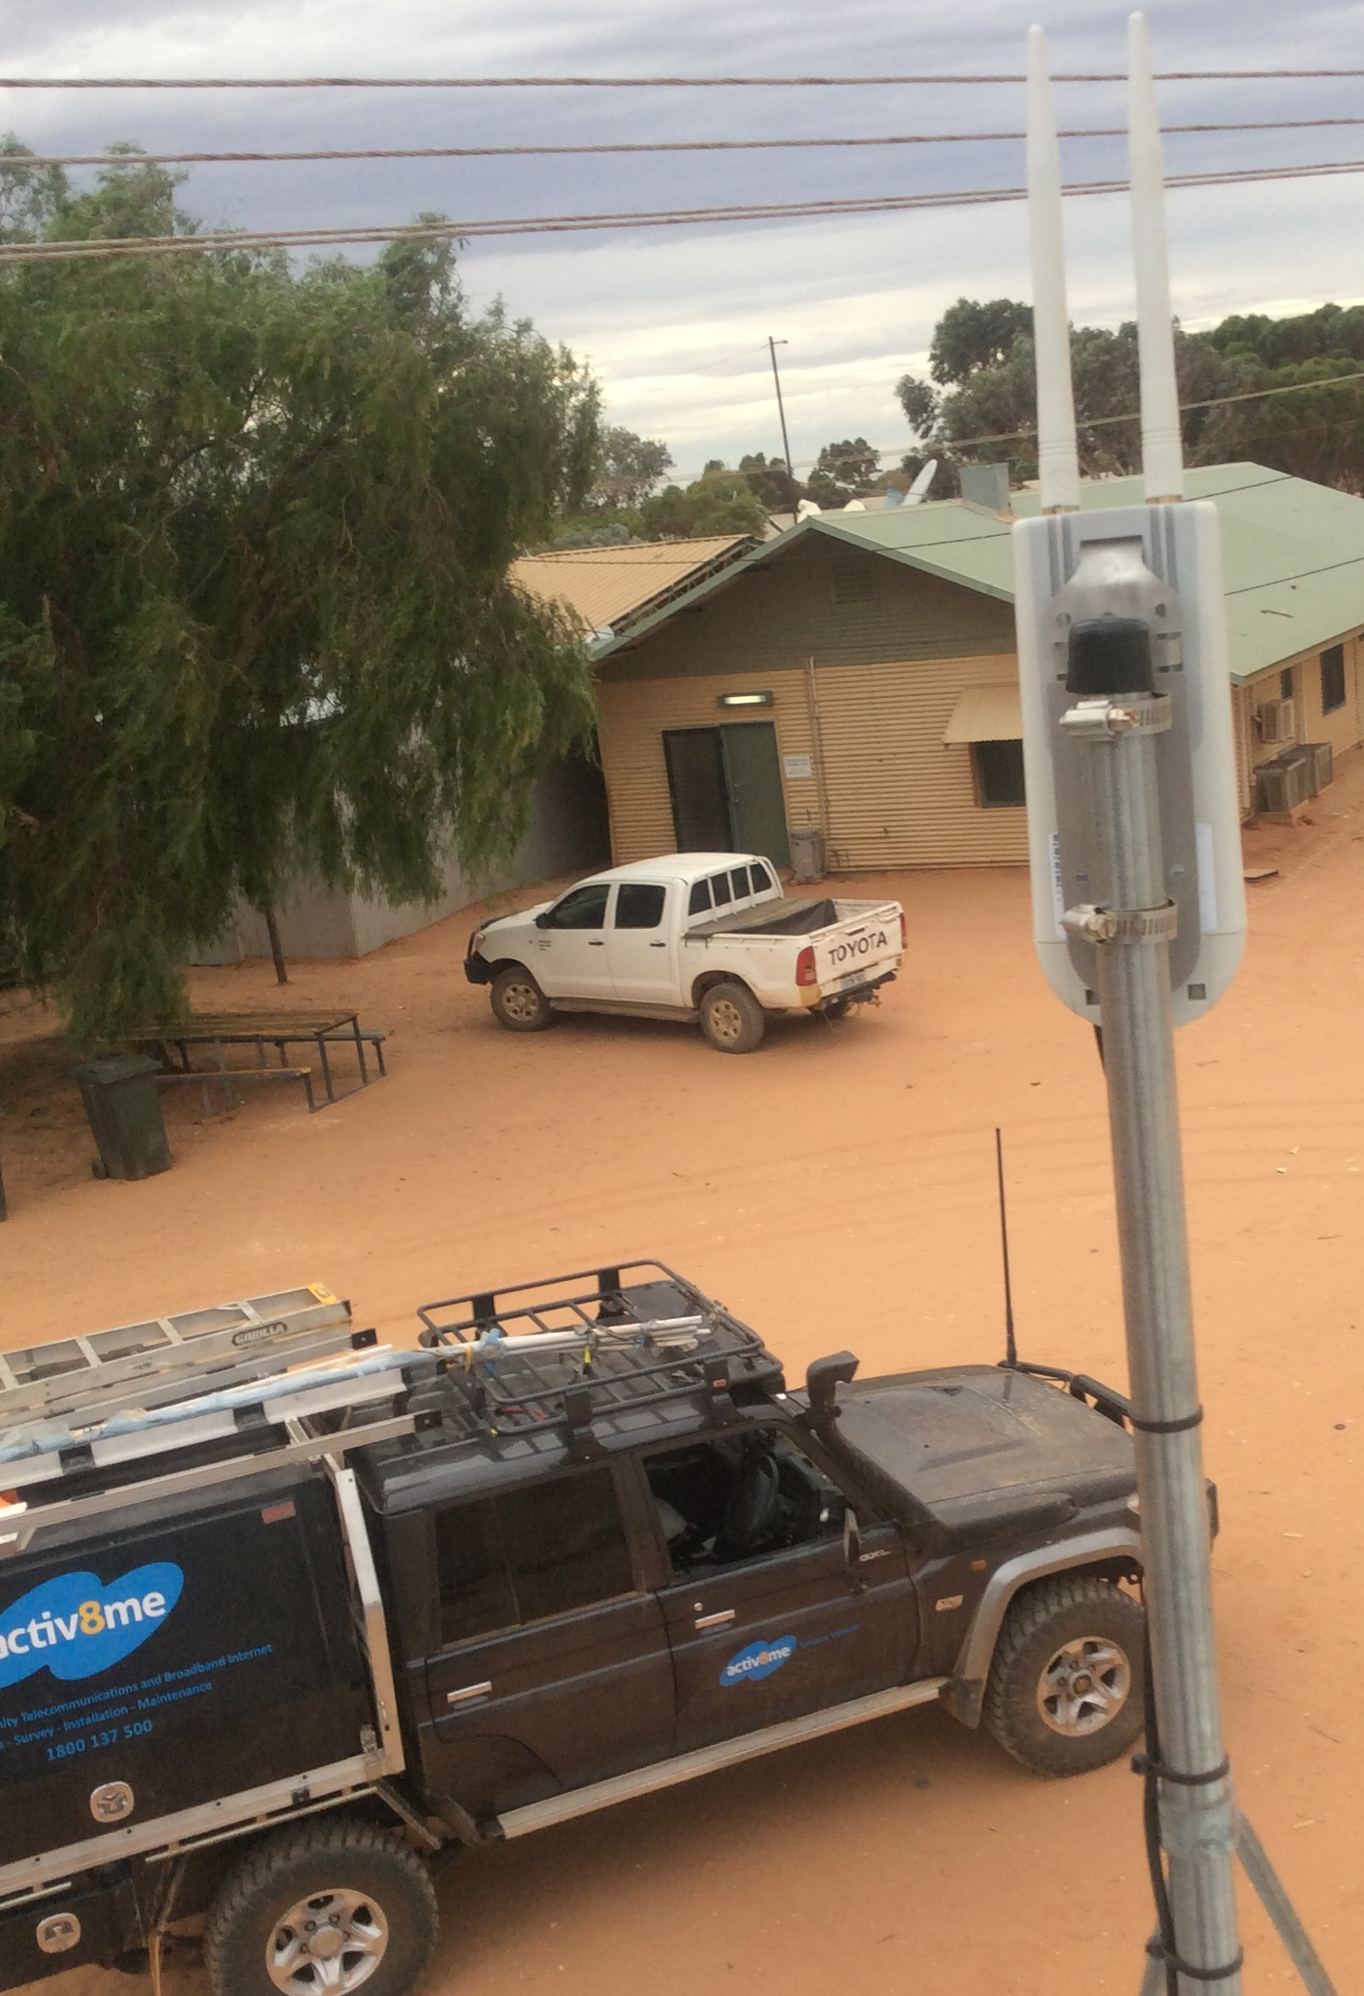
Activ8me Connecting Australians
August 2016

Slide 2
About Activ8me
Australian Private Networks trading as Activ8me was formed in 2002 to serve rural, regional and remote Australian communities with satellite broadband, and are Australia's largest satellite internet provider
APN has installed and maintains 301 remote Indigenous community Wi-Fi phones which provide telephony and free public Wi-Fi services in each community, as part of the Australian Government’s Remote Community Telecommunications programme. See picture on slide 1 above
In 2011 Activ8me became an official NBN service provider (RSP). Activ8me has over 30,000 NBN customers across all regions of Australia and is the largest Satellite RSP
NBN Sky Muster satellite launched in April 2016 and provides the latest in high speed satellite broadband to over 412,000 premises
APN is fully accredited with the Queensland Government CCIQ QAssure programme
Broadband partner of NSW Farmers Association

Slide 3
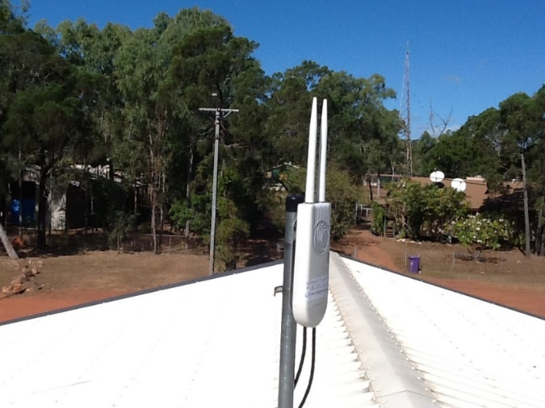
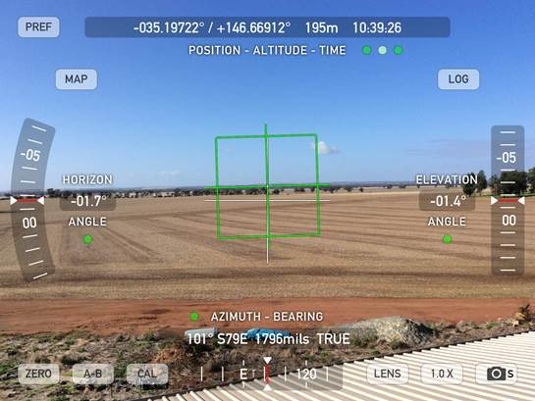
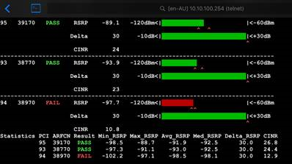
Going the extra mile
Activ8me provide extended nbn fixed wireless with point-to-point wifi
Islands program
Sky Muster
Federal Remote Community Telecommunications Program

Slide 4
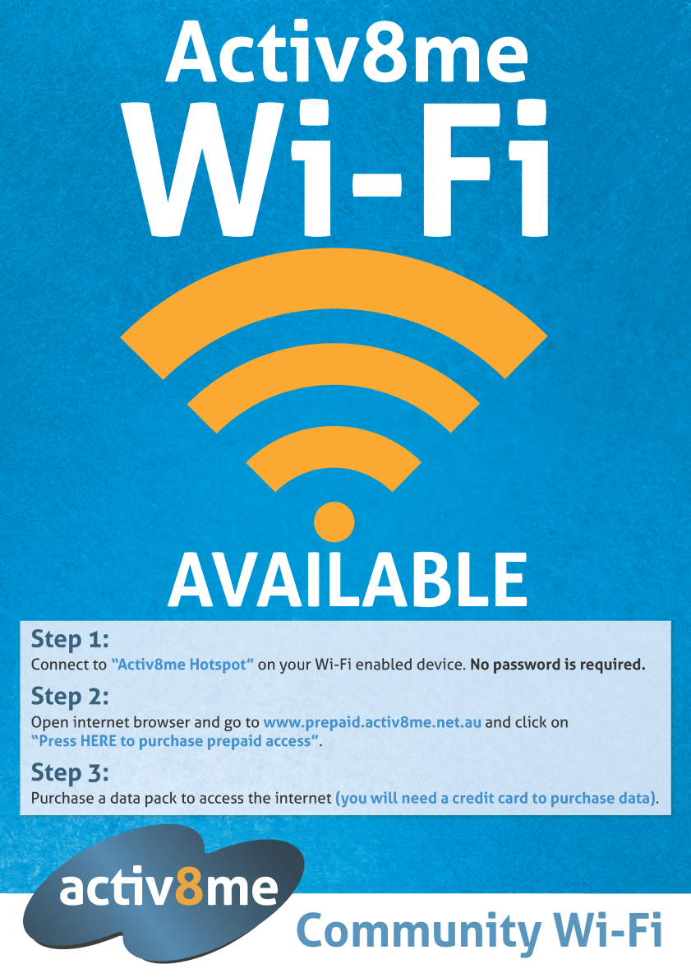
Servicing Regional Australia and remote locations without Mobile Coverage
Activ8me provides turn-key solution
Flexible Connection with Wi-Fi that supports:
The local community and its inhabitants
Visitors
Local staff
Access to Emergency Services
Supports all suitable Wi-Fi devices e.g. tablets, smart phones
Supports multiple VOIP applications providing low cost voice service outside mobile network

Slide 5
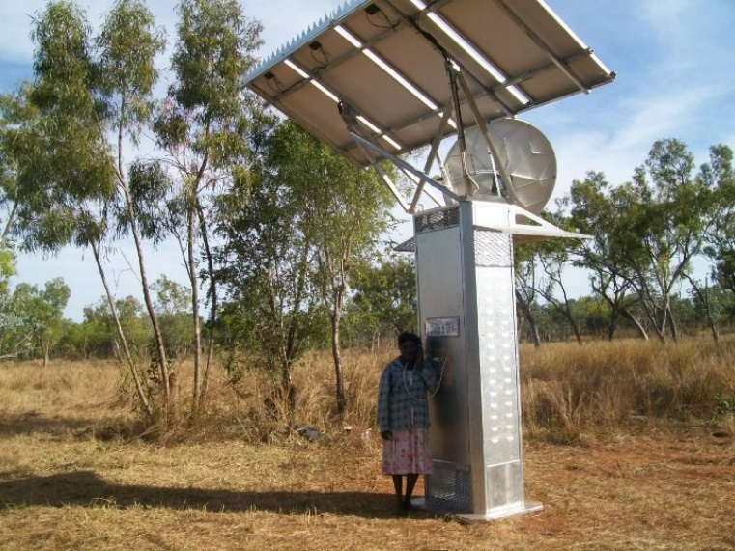
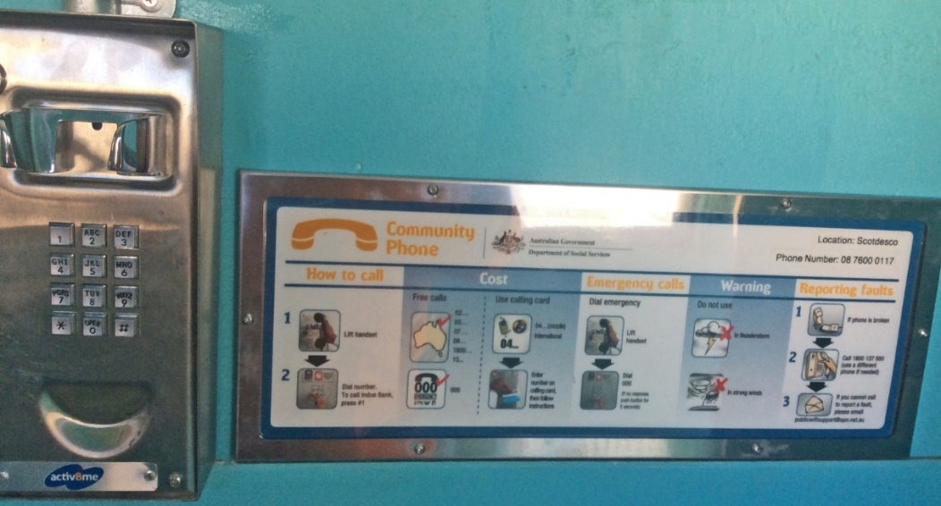
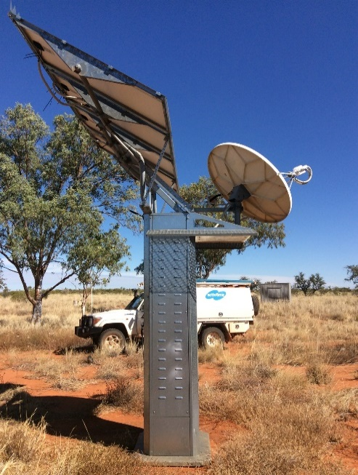
Activ8me Connecting Australians
Ian Roberts
GM Marketing
0403 077 072
Ian.roberts@apn.net.au

