Slide 1
Regional Telecommunications Review 2018

Slide 2
Committee Members
Mr Sean Edwards (Chair)
Ms Wendy Duncan
Ms Johanna Plante
Ms Robbie Sefton
Ms Kylie Stretton
Mr Paul Weller

Slide 4
Out in the Regions
Tamworth – public consultation
Port Augusta – public consultation

Slide 5
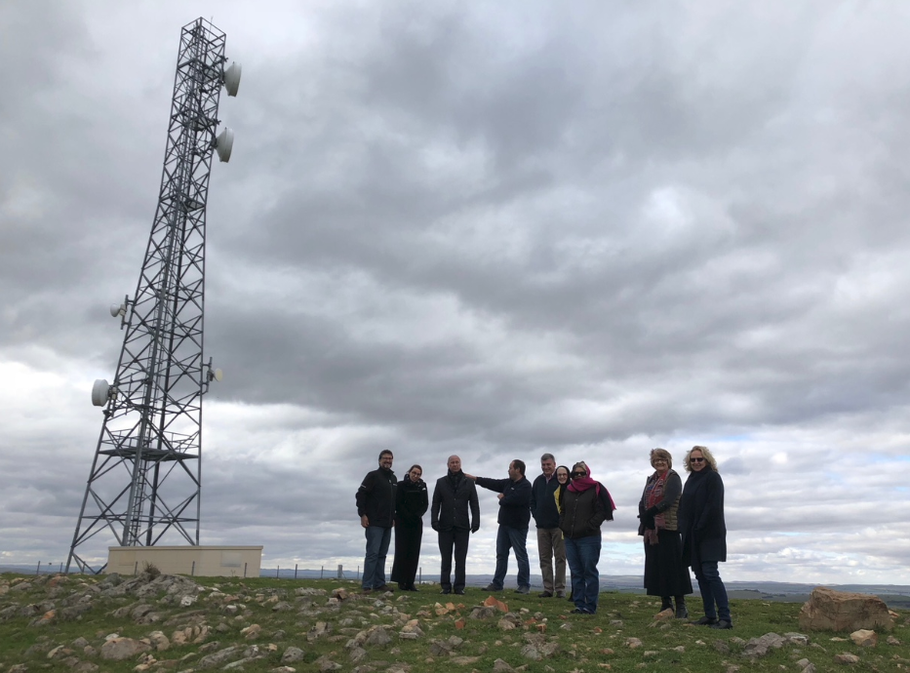
Out in the Regions
Kalgoorlie-Boulder
Clare Valley

Slide 6
Key themes of the Committee’s report into regional, rural and remote telecommunications in Australia
The demand for quality telecommunications services in regional Australia has never been greater.
The unprecedented year on year growth in demand for data is placing pressure on regional telecommunications networks.
Low levels of digital literacy among regional Australians, meaning many are unable to benefit from digital technologies and services available.
Uncertainty and concern around the pace and scale of change.
Notes:
UI

Slide 7
Next Steps
The Committee is expected to report to the Minister for Regional Communications by 30 September 2018.
The report will set out recommendations to the Australian Government.
The Government has a legislative obligation to respond to the report within six months.

Slide 8
For more information:
Visit The Department of Communications and the Arts’ website www.communications.gov.au/rtirc
Email secretariat@rtirc.gov.au
Post
2018 Regional Telecommunications Review Secretariat
Department of Communications and the Arts
GPO Box 2154
CANBERRA ACT 2601

