Slide 1
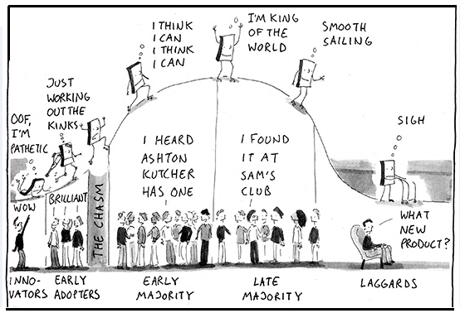
Connecting the Future Consumer
Notes:
In the very brief 10 minutes I have, connecting the future consumer will be contingent upon service providers understanding the customer experience, being user-centred or human-centred in the way they provide products, services and experiences.
In a technology landscape that is becoming increasingly diverse, the traditional language and discourse around “digital divides” is neither appropriate or suitable because it perpetuates these binary representations between “haves” and “have nots”, between those who are seen as champions and those who are seen losers, people we should feel sorry for.
Here we see Rogers technology adoption bell curve, which shows innovators and early adopters on the left, the group known as “laggards” who are right at the end of the spectrum. There’s actually an even worse category, known “sloths”, non-adopters, people who avoid participation in technology. Or they might also be called “Luddites”.
In research terms, much of the attention is on the left hand side of the bell curve, new and sexy technologies that are being introduced and the heavy users of technology. Young people and social media come to mind.

Slide 2
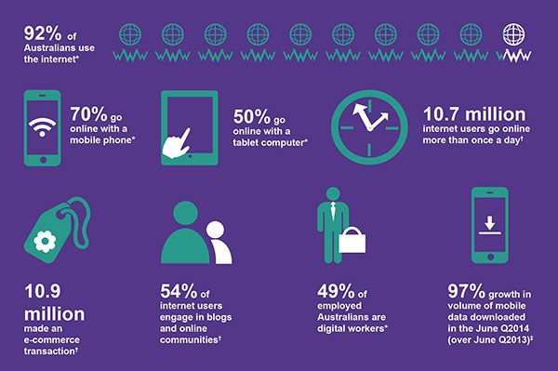
ACMA (2015) Australians’ Digital Lives
Notes:
In last year’s Australian Digital Lives report by Australian Communication & Media Authority, to qualify as being part of the 92% of Australian who use the Internet, you simply had to answer YES to the question “Have you used the Internet any time in the last six months?”.
This suggests only a small minority of Australians are not using the Internet, but if you accessed it once in the last six months, that qualifies you as being an online participant regardless of your:
Frequency of use
Level of digital literacy
Level of activity
The findings of the report clearly show that our technological landscape is becoming more diverse with an increase in more portable devices being used to go online.
However, if we want to advocate for future consumers, we need to be interested in what the report and similar stats DO NOT tell us.
For eg, the report emphasises that of the 92%of Australians, approx 20m, 10.7m (around half) go online more than once a day. The other half are made invisible.
Similarly, the data clearly shows that traditional desktop and laptop computers are the most often used devices for accessing the Internet, yet what is highlighted are those who are using mobile and tablets to do so.
Underlying this and other research on digital divides is an assumption that to be part of the 8% (probably more) who can’t or don’t use the internet, or haven’t done so in the six month duration of the study, is to be socially excluded or disadvantaged.
A small para in the report notes that age and income were the key factors associated with never having been online including:
Older adults over the age of 65
Those with incomes less than $30,000
Those without a university degree
Women

Slide 3
Groups on the ‘wrong’ side
New migrants and refugees
People from non-English speaking backgrounds
Older people
People of low socio-economic status
People in rural and remote areas
Indigenous communities
People with disabilities
Notes:
When you look across studies of digital disadvantage, the groups and communities that have been framed as being on the ‘wrong’ side of the ‘digital divide’ are…
Surely, if these are the groups and communities who are the laggards, sloths and Luddites, then this can no longer be considered a minor or ‘minority’ issue. We are talking about implications for the wider community and consumers in general when you consider that one in four Australians are from NESB. Over one million Australians are from a NESB AND have a disability. 20% of Australians self-identify as having a disability.

Slide 4
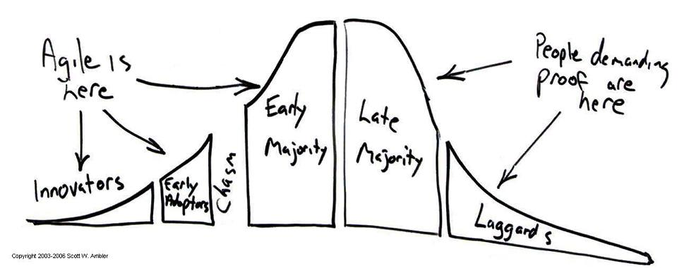
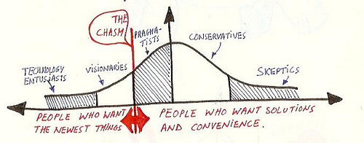
Notes:
So future organisations, businesses and service providers need to interrogate how they think about low participation or non-participation. Is it really something to be pitied? Or can we consider it an active position, a demand for proof that a technology be demonstrably useful and meaningful before it is adopted?
Or perhaps it can be regarded as a critical stance, one which highlights who has been privileged in the design of the technology and who has been excluded.
In other words, the attention needs to shift from the left side of the bell curve to the right side.

Slide 5
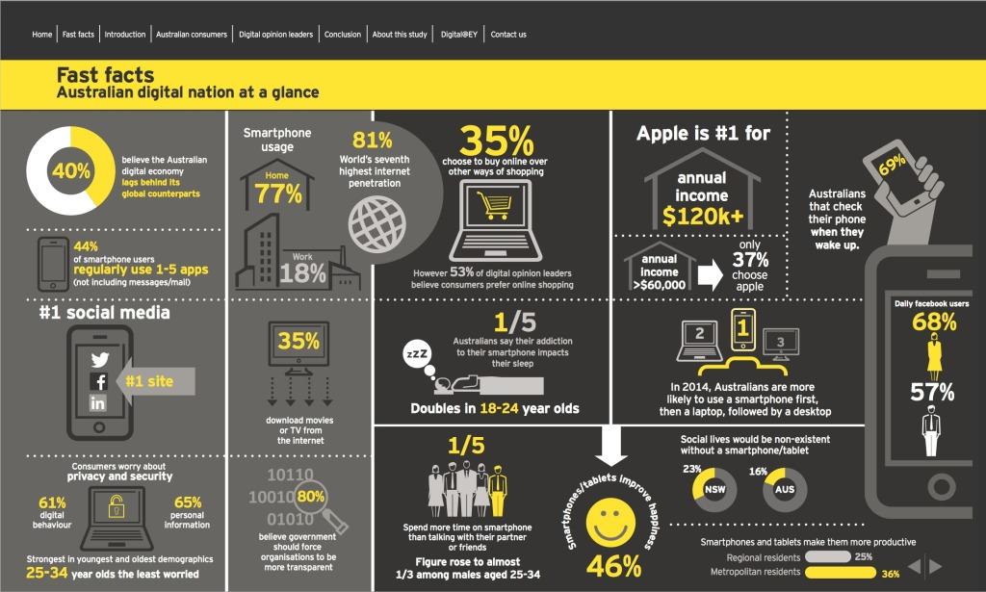
EY Sweeney (2014) Digital Australia: State of the Nation
Notes:
Let’s look at another report in terms of who and what is emphasised.
1 in 5 people surveyed for this report spend more time on their smartphone than talking with their partner or friends.
Up to 23% said that their social lives would be non-existent without a smartphone or tablet.
Again, what is highlighted is one end of the bell curve, the heavy users, the addicted users, the extreme users. Whereas for the majority of us, it would seem that we manage to have a social life without a huge reliance on or mediation by technology.

Slide 6
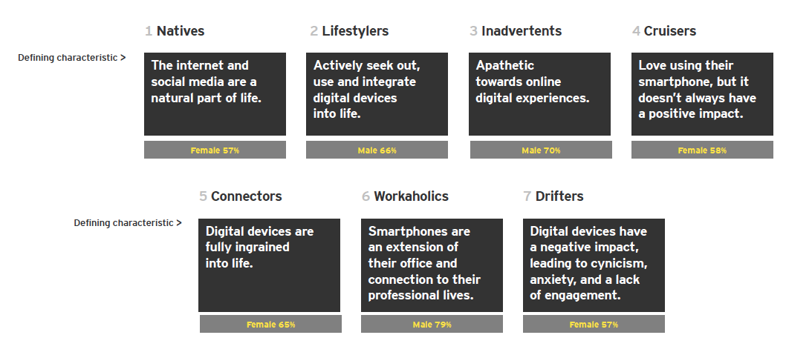
EY Sweeney (2014) Digital Australia: State of the Nation
Notes:
In that same report, they devise 7 categories of online participants.
Of those 7 categories, 4 would fit that left hand side of the tech adoption bell curve: they are the natives, lifestylers, the connectors and workaholics. So these are the early adopters, the heavy users, the extreme users, the ones who get the attention.
The other 3 make up the more neglected categories, but nevertheless, constitute that other end, possibly the other half of the bell curve. They are the cruisers, the inadvertents and the drifters.

Slide 7
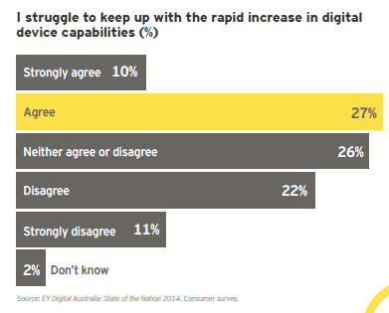
EY Sweeney (2014) Digital Australia: State of the Nation
Notes:
Some might say that I am making quite a claim. That a good chunk, maybe up to half of the population fall into those 3 neglected categories.
But this is backed up by their own data which indicates that well over a third of those surveyed struggled to keep up with the rapid increase in digital device capabilities.
Furthermore, 31% cited the government sector out of all sectors has having the worst digital experiences.
So what can be concluded from this? I would suggest that it shows a willful misunderstanding if not ignorance of how people use and participate in technology. It shows a win for techno-evangelism and the lure of the new.
We have research and statistics and infographics that focus attention on early adopters, on those who are using the newest, shiniest devices.
What is then overlooked are conventional practices, more traditional or older technologies that are being used.
As a result of that, online services and digital experiences are then designed without consideration to what most of us use, what most of us find familiar and comforting and perfectly usable.
When nearly one in three respondents are saying that govt online services - services that have to be used by everyone and so must be designed for universal use and access – are amongst the worst they have experienced, then there is a compelling basis for shifting our attention to:
The 37% who are struggling with the proliferation and plethora of devices in the tech landscape
The other end of the tech adoption bell curve, the right hand side
The laggards, the sloths, the Luddites.

Slide 8
FACT
There are 46% of Australians who don’t have the literacy skills to meet the most basic demands of everyday life and work.
►Adult Literacy and Life Skills Survey 2006
Notes:
What can we learn from those who can’t or don’t use the internet – their reasons for being offline, their alternative information and service-seeking practices – in order to design social solutions to more inclusive online services?
It means critically evaluating how the design of online environments may reinforce the existing age, class, gender and education bias.
It means being open to the possibility that this may not be a minority of stick-in-the-muds, but a significant number of us and people we know.
How many of us know someone who falls into this 46% of Australians? Some may not be able to read, others can but would find it difficult to get through a newspaper. Or would need help with following instructions on a medicine bottle, and figuring out what a Centrelink letter was asking them to do.

Slide 9
Notes:
This requires re-thinking the push towards e-government, in which all information and services of government departments are available online, often at the expense of cutting existing (traditional or non-digital) alternatives.
For example, to lodge business tax return, it is now only possible to do it online. The option for paper submission is no longer available.
Any future service provider will have to ask themselves some difficult questions:
Is this privileging of one technology over others essentially discriminatory? I would say it is on a number of levels.
It discriminates according the device you use, in that I would find information more quickly online than if I choose to call and ask a question. The user experience is deliberately better on one compared to another.
It discriminates according to your capacity to pay for the device you use, so that you are rewarded with better service if you invest in the appropriate hardware and Internet access, unlike one of my refugee research participants who only had a mobile phone and used his entire $30 of prepaid credit waiting on the line to speak to Centrelink.
It discriminates against the people who don’t own or have access to the right devices and platforms.
So the question then becomes: whose responsibility is it to ensure access? Where does the onus lie?

Slide 10
Notes:
If governments or businesses requires us to be good Netizens or consumers of the world, should they be responsible for ensuring access to the right devices and platforms for me to participate? Should they be designing their services and experiences to be as inclusive and accessible as possible?
Or is the onus on me to upskill myself and acquire the resources needed to participate?
I would argue that when it comes to digital exclusion, the latter argument has prevailed. And we see this in recommendations to boost digital literacy in communities through training. That is, as long as adequate training is available to those people on the wrong side of the digital divide, then they have the means to overcome their digital disadvantage.

Slide 11
Content literacies
Technical
literacies
Affordability
Notes:
Putting the onus back onto individuals for their access, means that blame for non-participation can then be easily apportioned to particular groups.
Perhaps more worryingly, it absolves service providers of their responsibility to ensure access not just availability.
Access to services is much more than boosting technical or digital literacies.
It equally about content and the way content is presented or delivered.
And equally about the costs incurred in gaining that access.
Instead of dichotomising user groups, with minorities supposedly representing those who are disadvantaged and deprived of devices, the onus must be on inclusive access ad service design that considers users as part of a spectrum of affordabilities, literacies and technologies through which services are accessed.
In short, connecting future consumers will be about service providers acknowledging, accommodating and designing for diversity.

Slide 12
Link to me au.linkedin.com/in/lindaleung247
Talk to me 0403 300 134
Tweet me @lindaleung247

