Slide 1
Office of the Australian Small Business and Family Enterprise Ombudsman
ASBFEO Ms Kate Carnell AO
ASBFEO – a snapshot
14 September 2016

Slide 2
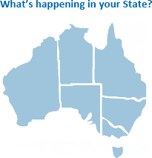
Small business overview
13,565
More than
2 million small businesses nation-wide
405,302
214,197
140,058
691,508
24,776
540,620
ACT
35,629

Slide 3
Open for Business
Scope of ASBFEO:
Fewer than 100 employees; or
Revenue of $5 million or less.
A small business operated as a family enterprise.
ADVOCATE
ASSIST
Research & inquiries
Comment on proposals
Provide advice to the Minister
Avoid litigation
Dispute resolution
Mediation

Slide 4
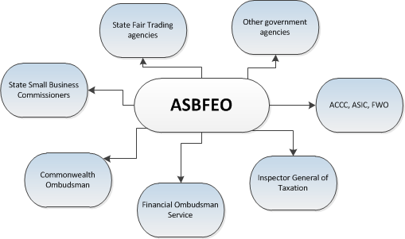
Here to help
The Ombudsman may refer disputes to:

Slide 5
Engaging with Small Business

Slide 6
Issues for Small Business
Payment times & Cash flow
Red tape
Banks
Telco issues

Slide 7
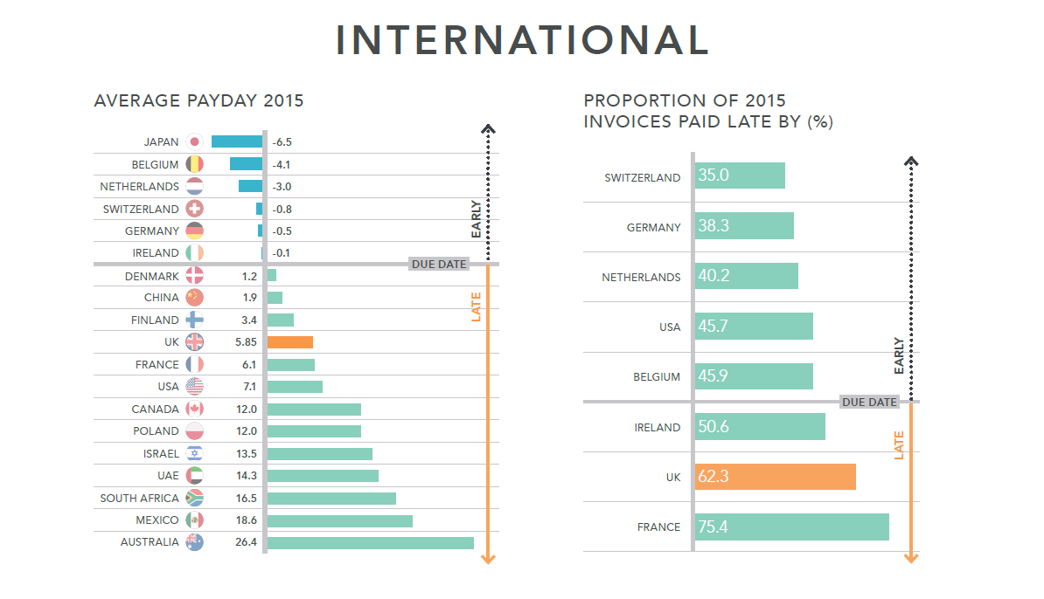
Payment times & Cash flow
*Source: Market Invoice – The State of Late Payment 2016

Slide 8
Red Tape
More than 1 in 4 respondents said they spent 11 hours a week or more on compliance
*ACCI 2015 National Red Tape Survey

Slide 9
Red Tape
ATO
Dept of employment
Department of health
Local councils
Safety regulators
Industrial relations
Commonwealth
State
*ACCI 2015 National Red Tape Survey

Slide 10
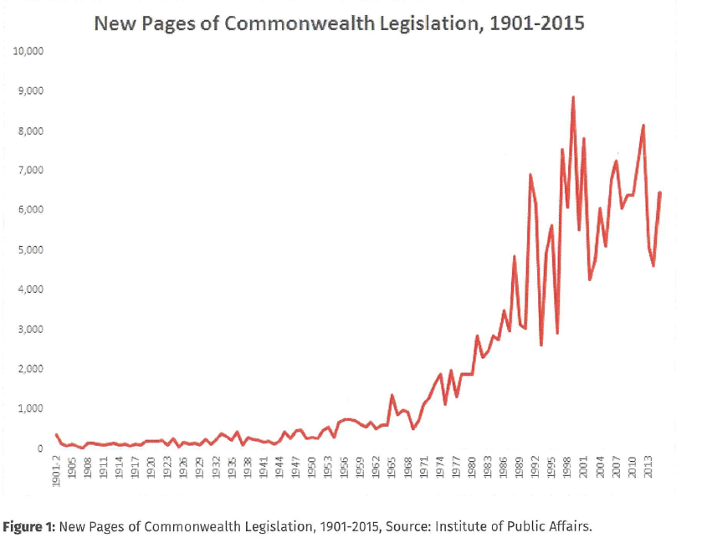
Red Tape

Slide 11
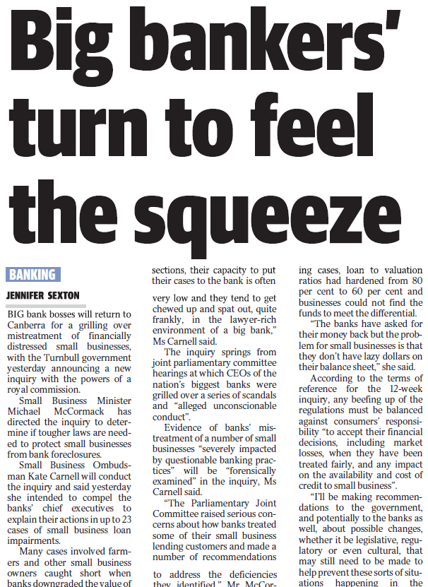
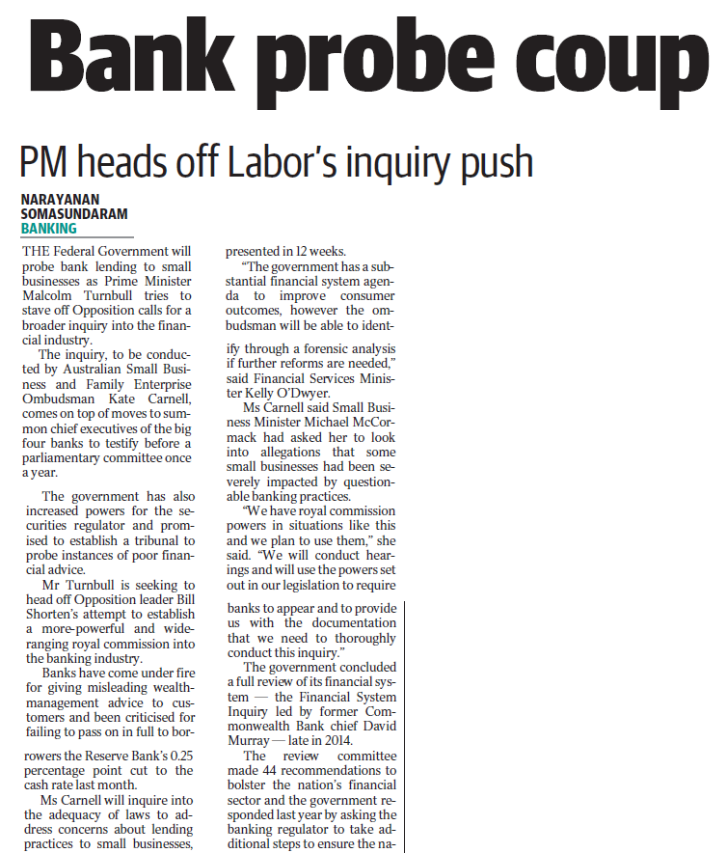
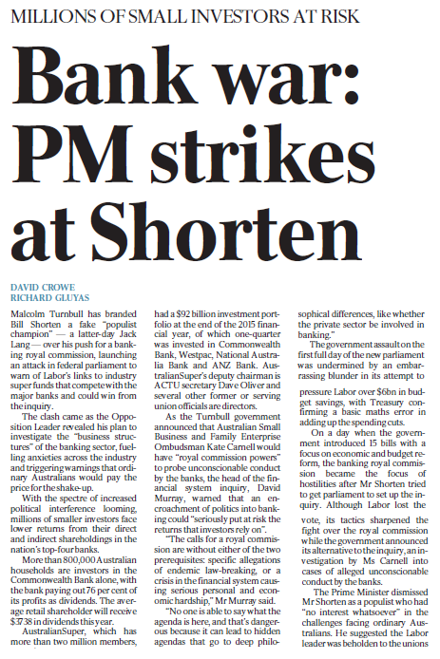
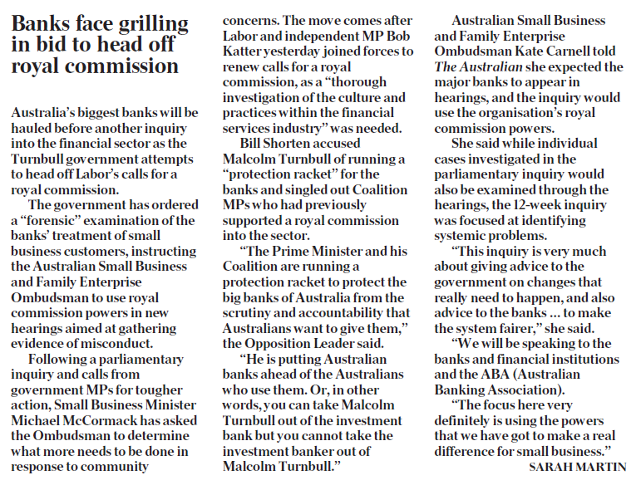
Banks

Slide 12
Telco – connectivity problems
Small business
Slow speeds
Wireless problems
Mobile black spots
High prices

Slide 13
Telco – Opportunities
x2
More likely to be growing revenue
$350,000
increase in annual revenue thanks to high digital engagement
*Deloitte Access Economics – ‘Connected Small Businesses’

Slide 14
Contact us:
Phone 1300 650 460
Email: info@asbfeo.gov.au
Twitter: @ASBFEO_AU
Facebook: @ASBFEO
Website: www.asbfeo.gov.au

