Slide 1
A new strategy for the TIO
Judi Jones, Ombudsman

Slide 3
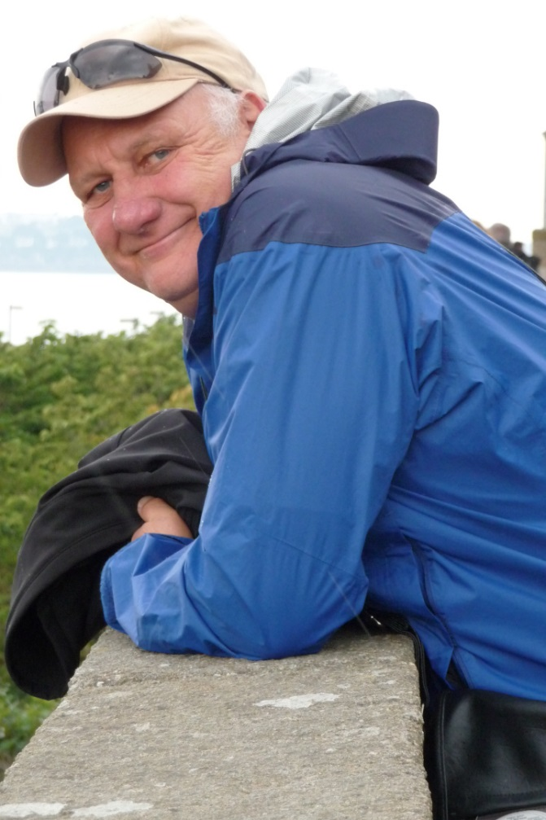
“first principles thinking”
“low hanging fruit”
“blue skies thinking”

Slide 4
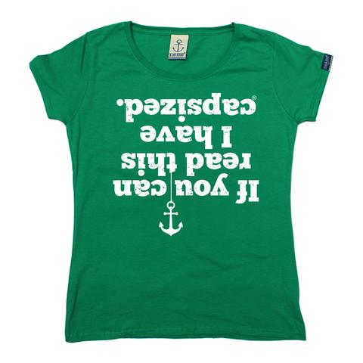

Slide 5
Sustainable and resilient organisation and infrastructure
Independent dispute resolution service that is efficient and effective, but doesn’t compromise our integrity
Collaborate and share knowledge with members and other stakeholders – reducing complaints and improving telco services
Be known, respected, and accessible

Slide 6
He tangata, he tangata, he tangata
If you were to ask me, ‘What is the most important thing in the world?’
I would reply ‘It is people, it is people, it is people’
Māori proverb

Slide 7
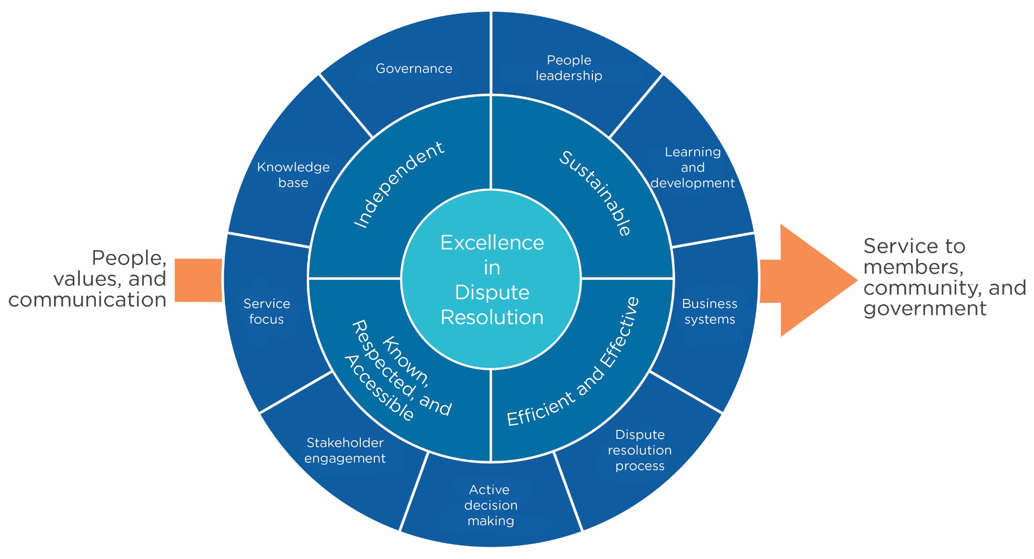

Slide 8
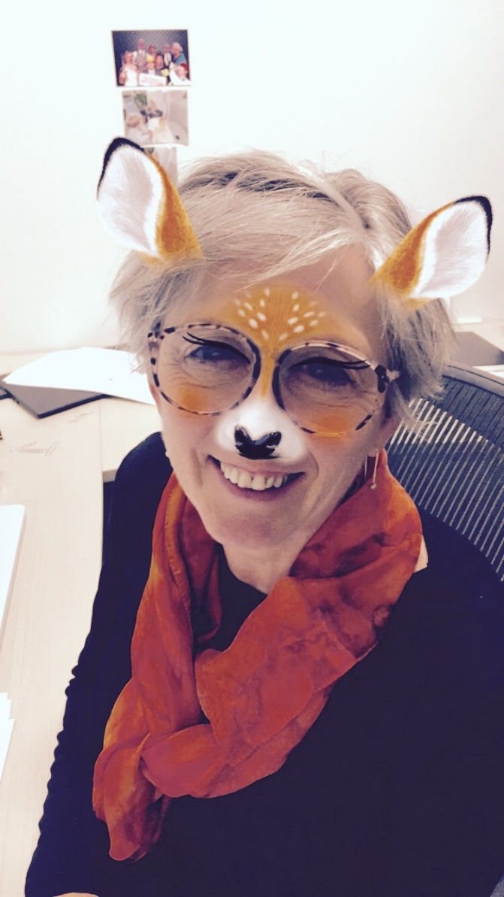
Welcome to the TIO

